Slide 1

E-Safety
Parent Workshop 2026
Keeping your children safer online
What is E-Safety?
Practical Tips for Parents
Online Risks Today
Supporting Your Child
Warning Signs
Resources & Next Steps

Slide 2



What is E-Safety?
E-Safety means using technology safely, responsibly and with respect — covering the internet, social media, gaming, messaging apps and AI tools.
Content
Contact
Conduct
What children see, read, watch and access online — including harmful, hateful or age-inappropriate material.
Who children communicate with online — including strangers, groomers, cyberbullies and unknown adults.
How children behave online — including sharing personal data, sexting, and their digital footprint.
+ Conduct also includes how YOUR digital habits model behaviour for your children.

Slide 3
The Digital Landscape in 2026
What children are using — right now
97%
of children aged 9–16 use the internet weekly
1 in 3
internet users worldwide are children
13
is the minimum age for most social platforms — but 44% of under-13s have accounts
6hrs+
average daily screen time for UK teenagers
72%
of young people say they've seen disturbing content online
AI
tools including chatbots, deepfakes and image generators are now regularly used by children

Slide 4





Online Risks: What to Know in 2026
Grooming & Sexual Exploitation
Abusers use social media, gaming and messaging apps. Grooming can happen in weeks. Groomers may also be other young people.
Cyberbullying & Harassment
Unlike traditional bullying it follows children home. Screenshots and resharing can escalate harm rapidly. 1 in 5 young people experience cyberbullying.
Harmful & Radicalising Content
Age-inappropriate content, self-harm material, extremist ideology and disordered eating communities can be algorithmically recommended.
Privacy & Data Risks
Oversharing location, school name or daily routines. Children rarely read privacy policies and apps harvest data by default.
Deepfakes & AI-Generated Content
AI can now convincingly create fake images and voices. Children may be targets of image-based abuse using AI tools.

Slide 5
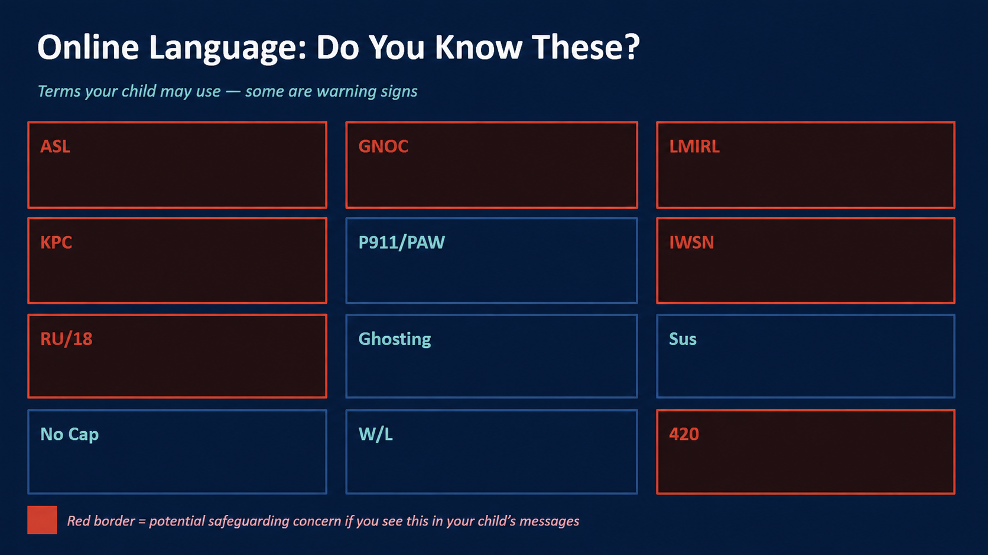

Slide 6
Online Language: Do You Know These?
Terms your child may use — some are warning signs
ASL
Age / Sex / Location
GNOC
Get Naked On Camera
LMIRL
Let's Meet In Real Life
KPC
Keep Parents Clueless
P911/PAW
Parent Alert / Parents Are Watching
IWSN
I Want Sex Now
RU/18
Are You Over 18?
Ghosting
Suddenly ignoring someone online
Sus
Suspicious / Among Us game slang
No Cap
No lie / seriously (slang)
W/L
Win / Loss — rating someone
420
Reference to cannabis
Red border = potential safeguarding concern if you see this in your child's messages

Slide 7

Warning Signs to Watch For
Switching screens or closing devices suddenly when you enter the room
Becoming secretive about who they are talking to online
1
2
Spending much more (or much less) time online than usual
Unexplained gifts, money, phone credit or new devices
3
4
Emotional withdrawal, anxiety, low mood — especially after using their device
Using adult language, sexual references or showing knowledge beyond their years
5
6
New 'friends' who they haven't met in person and are reluctant to talk about
Wanting to meet someone from online, or actually meeting up in secret
7
8
Remember: These signs may have innocent explanations. Stay calm — your response shapes whether your child comes to you next time.

Slide 8
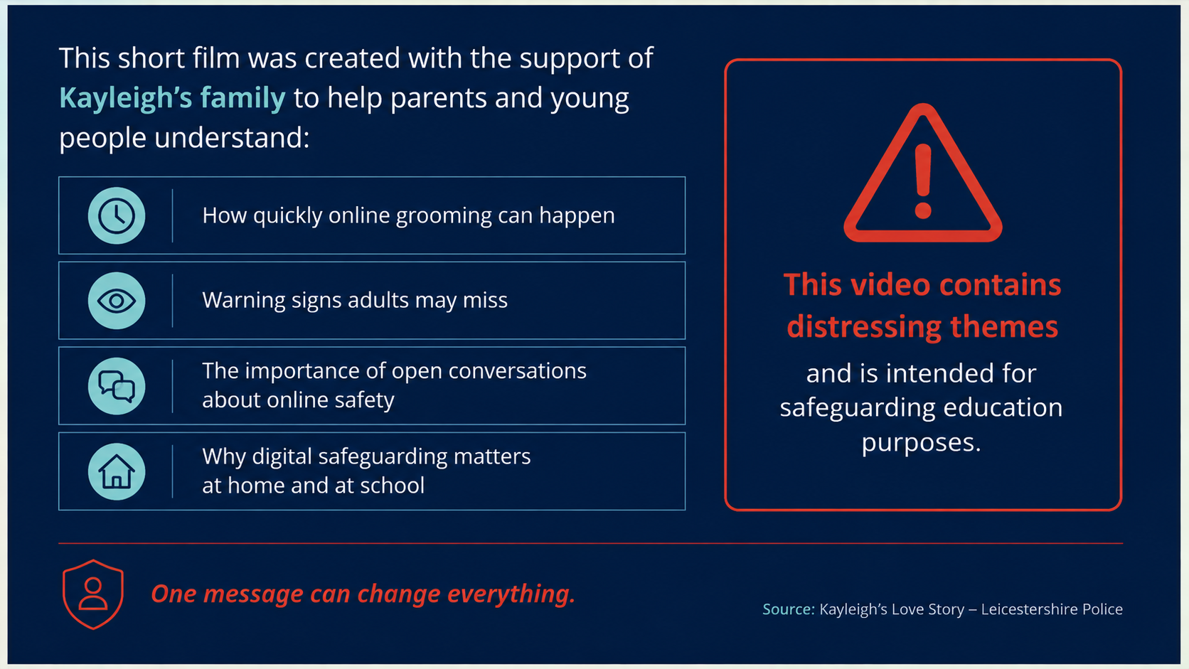

Slide 9
Grooming: What Parents Need to Know
Grooming is when someone builds an emotional connection with a child to gain their trust, with the purpose of sexual abuse, exploitation or radicalisation.
It happens across ALL platforms
Instagram, Snapchat, TikTok, Discord, Roblox, Fortnite and Minecraft all have messaging. Groomers go where children are.
Groomers can be other young people
Not always an older adult. Sexual exploitation networks sometimes use peer groomers of a similar age.
Secrecy is the key tool
Groomers create a world where they are the only trusted adult. Watch for your child feeling they must hide a friendship.
It can happen very quickly
Cases have involved children being groomed within 2 weeks of first contact. Regular check-ins matter.
If you suspect your child is being groomed: contact your school's Designated Safeguarding Lead (DSL), CEOP (Child Exploitation and Online Protection), or call the police.

Slide 10
Online Gaming
Roblox, Fortnite, Minecraft and more — what parents need to know
Gaming is where millions of children socialise, create and compete — it also carries real risks

Slide 11
Online Gaming: What Parents Need to Know
Most popular games have chat, voice and friend features — understanding each platform helps you keep children safe
🎮 Roblox
🎯 Fortnite
⛏ Minecraft + others
Ages 7+ / PEGI 7
Online platform with millions of user-made games. Has in-game chat and voice features. Children can receive friend requests from strangers.
Key risks:
Grooming via in-game chat or private messages
Robux (virtual currency) scams and phishing
Age-inappropriate user-created content
Tips:
Enable Account Restrictions in settings
Turn off chat for under-13s
Link a parent email to their account
Ages 12+ / PEGI 12
Battle royale game played with 100 players. Voice and text chat with random strangers. Hugely popular with secondary age children.
Key risks:
Voice chat with strangers during gameplay
Bullying and toxic behaviour in-game
Pressure to buy V-Bucks (real money)
Tips:
Mute voice chat or play with friends-only
Set spending limits in Epic Games settings
Play together occasionally to understand it
Ages 7+ / PEGI 7
Creative sandbox game. Multiplayer servers mean contact with strangers. Also: Call of Duty, FIFA, GTA (18+) often played by under-18s.
Key risks:
Public servers with no age verification
GTA / 18+ games accessed by younger teens
Games used as gateway to Discord chats
Tips:
Check PEGI ratings before buying games
Use private/invite-only servers only
Ask what apps they use alongside gaming

Slide 12
Social Media & Messaging Apps
Snapchat, Discord, Instagram and TikTok
These apps are designed to be engaging — understanding them helps you have informed conversations with your child

Slide 13
Social Media & Messaging Apps: A Parent’s Guide
📸 Snapchat
💬 Discord
📷 Instagram
🎵 TikTok
Age 13+ (widely used by younger children)
Photos and videos disappear after viewing. Children feel it is “safer” because content vanishes — screenshots still work.
Risks:
Sexting and image-sharing pressure
Snap Map shows real-time location
Contact from unknown strangers
Tips:
Turn off Snap Map (Ghost Mode)
Set account to friends-only contact
Remind children screenshots are permanent
Age 13+ (often used younger children)
Chat app with servers, voice and video. Primarily used alongside gaming but hosts communities of all kinds — including harmful ones.
Risks:
Access to extremist or adult content servers
Private DMs and grooming by strangers
Hard to monitor — many hidden channels
Tips:
Know which servers they are in
Disable DMs from non-friends
Review friend list together regularly
Age 13+ (widely used earlier)
Photo/video sharing with algorithms that can push harmful content. DMs allow private contact with strangers.
Risks:
Body image and self-esteem pressures
Harmful content via Reels algorithm
Cyberbullying and impersonation
Tips:
Set account to private
Enable Instagram “Teen Account” mode
Talk about social comparison openly
Age 13+ (widely used by under-13s)
Short video platform with highly personalised algorithm. Content can rapidly shift toward extreme or harmful topics.
Risks:
Algorithmically pushed harmful content
Live streaming — gifts from strangers
Duet/Stitch used to harass children
Tips:
Enable Family Pairing in settings
Disable DMs and restrict comments
Turn off Live feature for under-16s

Slide 14
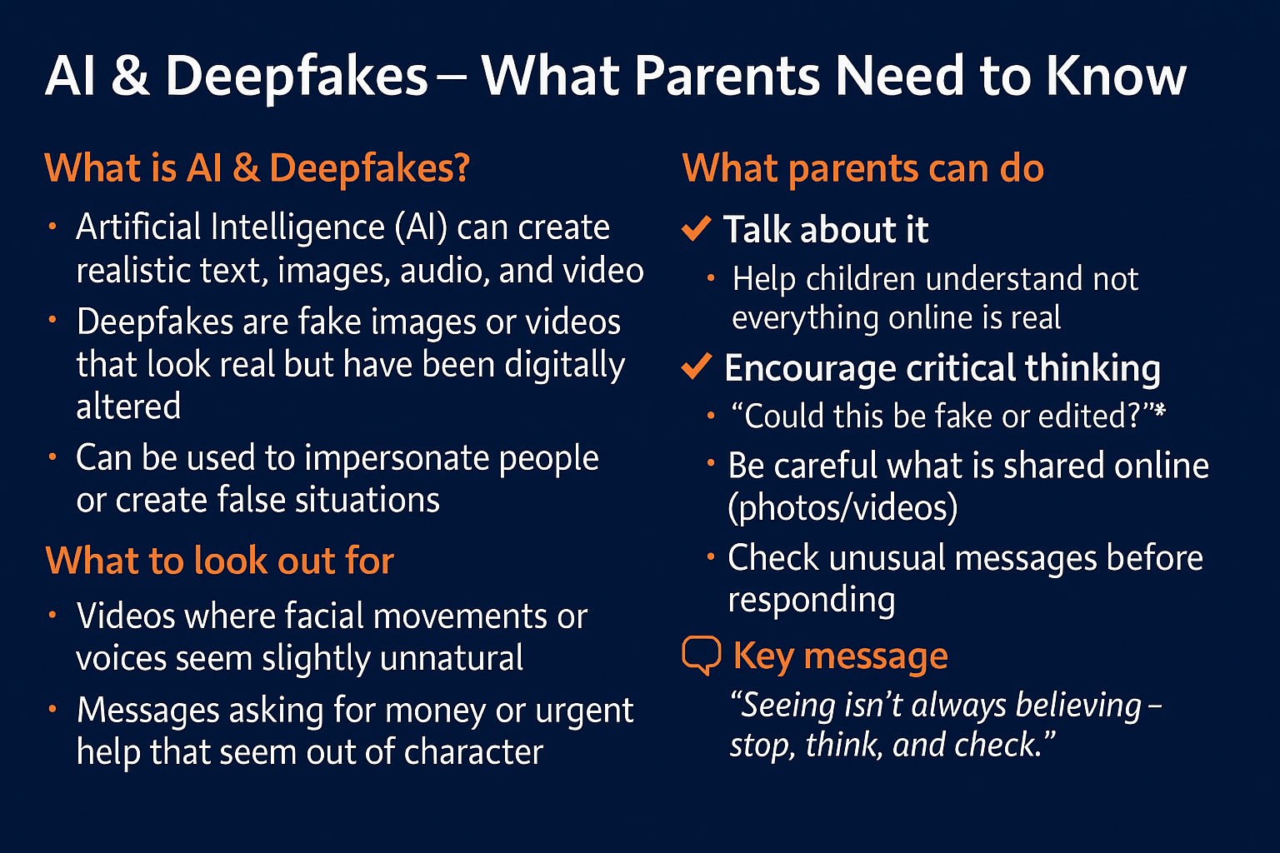

Slide 15





Practical Tips for Parents
Devices in shared spaces
Enable parental controls
Talk about it regularly
Keep screens in family rooms, especially at night. Charge devices outside bedrooms — this also helps sleep.
Use your ISP's family filter (e.g. BT, Sky, Virgin all offer free filtering). Set up Google SafeSearch and YouTube Restricted Mode.
Don't make it a 'big talk' — weave it into daily conversation. Ask 'what funny/weird things did you see online today?'
Know what they play & watch
Privacy settings together
Stay the trusted adult
Check PEGI ratings on games (pegi.info). Use Common Sense Media (commonsensemedia.org) for film, TV and app reviews.
Sit with your child and review privacy settings on their apps. Who can see their profile? Who can message them?
Make it clear they will NEVER get in trouble for telling you something uncomfortable online. Your reaction determines if they come back.

Slide 16
Screen Time: Quality Over Quantity
✓ Benefits of Technology
⚠ Potential Concerns
Learning & homework support
Disrupted sleep if used late at night
Creative expression (art, music, coding)
Passive consumption vs. active engagement
VS
Staying connected with family & friends
Exposure to harmful content or contacts
Building digital skills for the future
Impact on physical activity levels
Entertainment and stress relief
Social comparison and self-esteem

Slide 17
How to Have the Conversation
DO
AVOID
✓ Start early — don't wait for a problem to arise
✗ React with anger or panic — this closes down honesty
✓ Use news stories or TV as a natural conversation starter
✗ Remove devices immediately as the first response
✓ Ask open questions: 'What do you think about...?'
✗ Spy secretly — if discovered, trust is broken
✓ Be genuinely curious, not interrogative
✗ Assume you know more than they do about specific apps
✓ Praise them for coming to you with concerns
✗ Make them feel ashamed for things they've seen
✓ Share your own uncertainty — 'I'm not sure about that, let's look together'
✗ Wait until secondary school to start these conversations

Slide 18



What We Do at School
Your child's e-safety education doesn't just happen at home
Curriculum Coverage
Safer Internet Day
E-safety is embedded across Computing, PSHE and RSE. Children learn about privacy, digital footprints, online relationships and critical evaluation of information.
We mark Safer Internet Day (February) each year with whole-school activities and class discussions.
Designated Safeguarding Lead
Filtered Network
Our DSLs are trained in online safety. Any concerns reported to us — by children, staff or parents — are acted upon with appropriate confidentiality.
Our school network uses commercial filtering. However no filter is 100% effective — which is why education and conversation remain essential.

Slide 19
Useful Resources for Parents
NSPCC Net Aware
Thinkuknow (CEOP)
net-aware.org.uk
thinkuknow.co.uk
Parent-friendly guides to apps, games and social networks your child uses
Resources for all ages from the UK's child protection command. Report a concern via ceop.police.uk
Internet Matters
Common Sense Media
internetmatters.org
commonsensemedia.org
Step-by-step guides for parental controls on every device and platform
Age-based reviews of games, films, apps and websites
UK Safer Internet Centre
Childline
saferinternet.org.uk
childline.org.uk / 0800 1111
Helpline for parents and carers: 0344 381 4772 (Mon–Fri 10am–4pm)
Free, confidential helpline for children worried about anything online or offline

Slide 20
Key Messages to Take Away
Technology is a valuable tool — the goal is safety and resilience, not avoidance.
1
Your relationship with your child is your most powerful safeguarding tool.
2
Keep the conversation open, calm and ongoing — not a one-off 'big talk'.
3
No filter or parental control can replace education and trust.
4
If you're worried about your child's safety online — contact the school, CEOP or police.
5
Thank you for attending — you're already doing the most important thing.

