Slide 1
Human immunodeficiency virus (HIV)
Healthy intimate relationships: How can sex be safe?

Slide 2
I can explain what HIV is, how it is transmitted, its transmission rates, and how it affects the immune system.

Slide 3






Listen to others. It is okay to disagree with each other, but we should listen properly before making assumptions or deciding how to respond. When disagreeing, challenge the statement not the person.
Respect privacy. We can discuss examples but do not use names or descriptions that identify anyone, including ourselves.
Choose level of participation. Everyone has the right to choose not to answer a question or join discussion. We never put anyone ‘on the spot’.
No judgement. We can explore beliefs and misunderstandings about a topic without fear of being judged.
Laura
Andeep
Jacob
Izzy

Slide 4
HIV
short for human immunodeficiency virus; a virus that attacks the immune system
CD4 cell
a type of white blood cell that is targeted and destroyed by HIV
AIDS
short for acquired immunodeficiency syndrome; the most advanced stage of HIV infection

Slide 5
transmission
passing an infection from one person to another
ART
short for antiretroviral therapy; a treatment for HIV that helps manage the virus

Slide 6

Human immunodeficiency virus (HIV)
What is HIV?
How is HIV transmitted?
What are the prevention and treatment options?

Slide 7
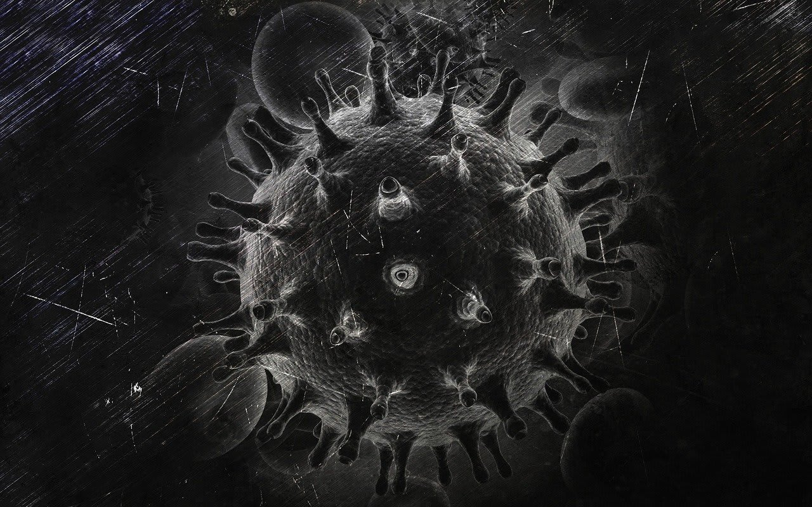
What is HIV?
Human immunodeficiency virus (HIV) is a virus that attacks the immune system, making it harder for the body to fight infections and diseases.
There is no cure, but treatment can help manage it effectively and people living with HIV can expect to live a normal lifespan.
An image of an HIV cell

Slide 8

What is HIV?
What does HIV stand for?
human immune virus
human immunodeficiency virus
human infection virus

Slide 9


What is HIV?
HIV attacks and destroys CD4 cells, which are crucial for the immune system. HIV is different from acquired immunodeficiency syndrome (AIDS). AIDS is the most advanced stage of HIV infection that occurs when the immune system is severely damaged. However, with proper treatment, most people with HIV in the UK do not develop AIDS.
Nurse Daniel

Slide 10
What is HIV?
What type of cells does HIV destroy?
CD4 cells
platelet cells
red blood cells

Slide 11
What is HIV?
HIV can be transmitted through specific bodily fluids, such as blood, semen, vaginal fluids and breast milk.
It is commonly thought that only certain groups of people can get HIV. However, this is not true. HIV can affect anyone regardless of age, gender, sexual orientation or socio-economic status.

Slide 12
What is HIV?
HIV can be transmitted through specific body fluids.
Why?
HIV can be transmitted through specific bodily fluids, such as blood, semen, vaginal fluids and breast milk.

Slide 13
What is HIV?
Read the following statements and decide if they are true or false.
HIV can be transmitted through breast milk.
HIV can be transmitted by hugging.
Only certain groups of people can get HIV.
HIV attacks your red blood cells.

Slide 14
What is HIV?
Read the following statements and decide if they are true or false.
Your answers should include:
HIV can be transmitted through breast milk. True
HIV can be transmitted by hugging. False
Only certain groups of people can be affected by HIV. False
HIV attacks your red blood cells. False

Slide 15
What is HIV?
Rewrite the false statements so they are correct.
HIV can be transmitted by hugging.
Only certain groups of people can get HIV.
HIV attacks your red blood cells.

Slide 16
What is HIV?
2) Rewrite the false statements. Your answers might include:
HIV can be transmitted by hugging.
HIV cannot be transmitted by hugging. It is transmitted through specific bodily fluids, such as blood, semen, vaginal fluids and breast milk.
Only certain groups of people can be affected by HIV.
HIV can affect anyone regardless of age, gender, sexual orientation or socio-economic status.
HIV attacks your red blood cells.
HIV attacks and destroys CD4 cells, which are white blood cells crucial for the immune system.

Slide 17
Human immunodeficiency virus (HIV)
What is HIV?
How is HIV transmitted?
What are the prevention and treatment options?

Slide 18
How is HIV transmitted?
Transmission rates of HIV depend on several factors, including the type of exposure and the presence of other sexually transmitted infections (STIs).
The type of exposure means how someone comes into contact with HIV in the first place.
Nurse Daniel

Slide 19
How is HIV transmitted?
STIs can make it easier for HIV to get into the body. This happens because:
STIs that cause sores (like herpes) create open wounds that allow HIV to enter more easily
STIs that cause inflammation (like chlamydia or gonorrhoea) make the skin more fragile and prone to tears
some STIs increase the number of CD4 cells in the genital area, which are the exact cells HIV targets.
This is why treating STIs is important for reducing HIV transmission risk.

Slide 20
How is HIV transmitted?
Complete the sentence to explain why the presence of other STIs can increase the risk of HIV transmission:
STIs can cause sores or inflammation, making it…
…easier for HIV to get into the body.

Slide 21
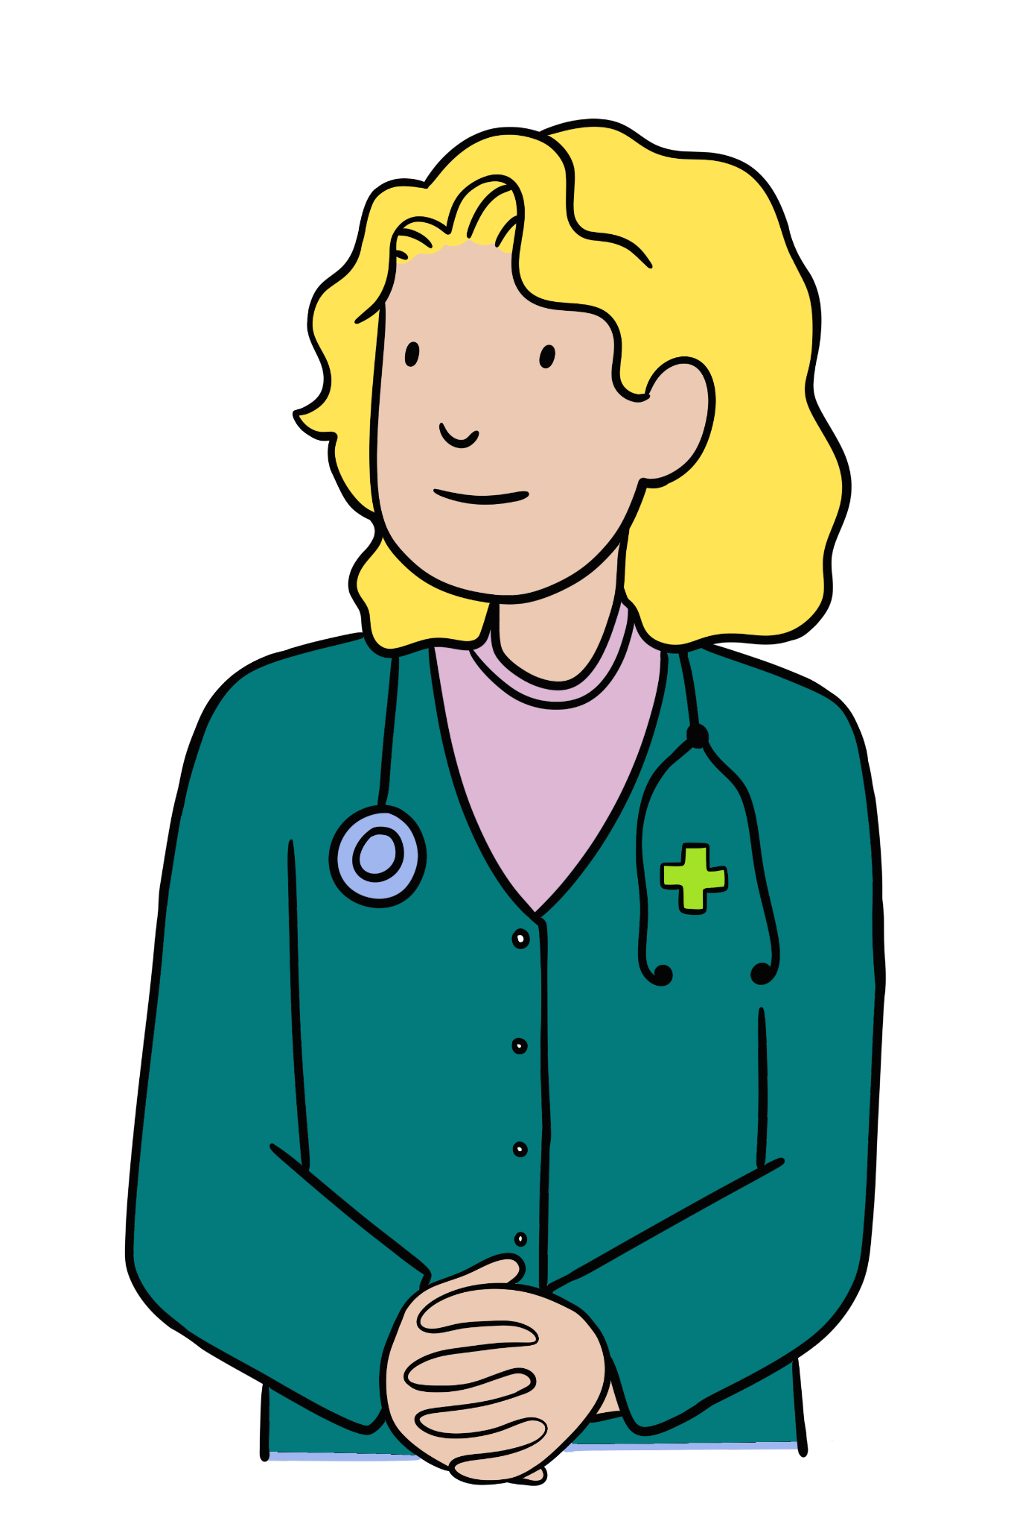
How is HIV transmitted?
Unprotected sexual contact has a higher transmission rate compared to protected sexual contact.
Using condoms during sex is an effective way to reduce the risk of HIV transmission. Condoms are a type of barrier method of contraception. They work by creating a physical barrier that stops bodily fluids, like semen or vaginal fluids, from passing between partners, which helps prevent the spread of HIV.
Dr Elsie

Slide 22
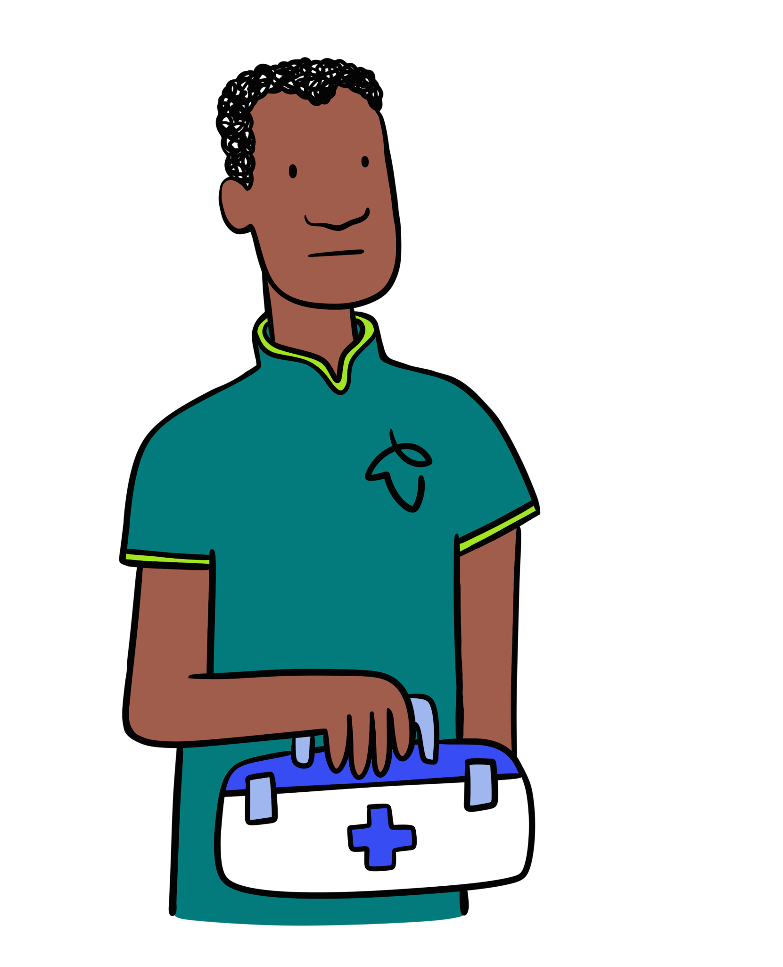
How is HIV transmitted?
Sharing needles and syringes significantly increases the risk of HIV transmission.
Sharing needles and syringes is dangerous because it can transfer blood from one person to another. If someone has HIV, it can travel in the blood left in the needle, putting others at high risk of infection.
Nurse Daniel

Slide 23
How is HIV transmitted?
It’s important to note that HIV cannot be transmitted through:
casual contact (like shaking hands, hugging or kissing on the cheek)
sharing food, drinks or eating utensils
swimming pools or hot tubs
insect bites or animal bites
saliva, tears or sweat (unless mixed with blood)
toilet seats or door handles
coughing or sneezing
living or working with someone who has HIV
sharing towels, bedding or clothing.

Slide 24
How is HIV transmitted?
Which type of sexual contact has the highest transmission rate for HIV?
protected sexual contact
unprotected sexual contact
no difference between them

Slide 25
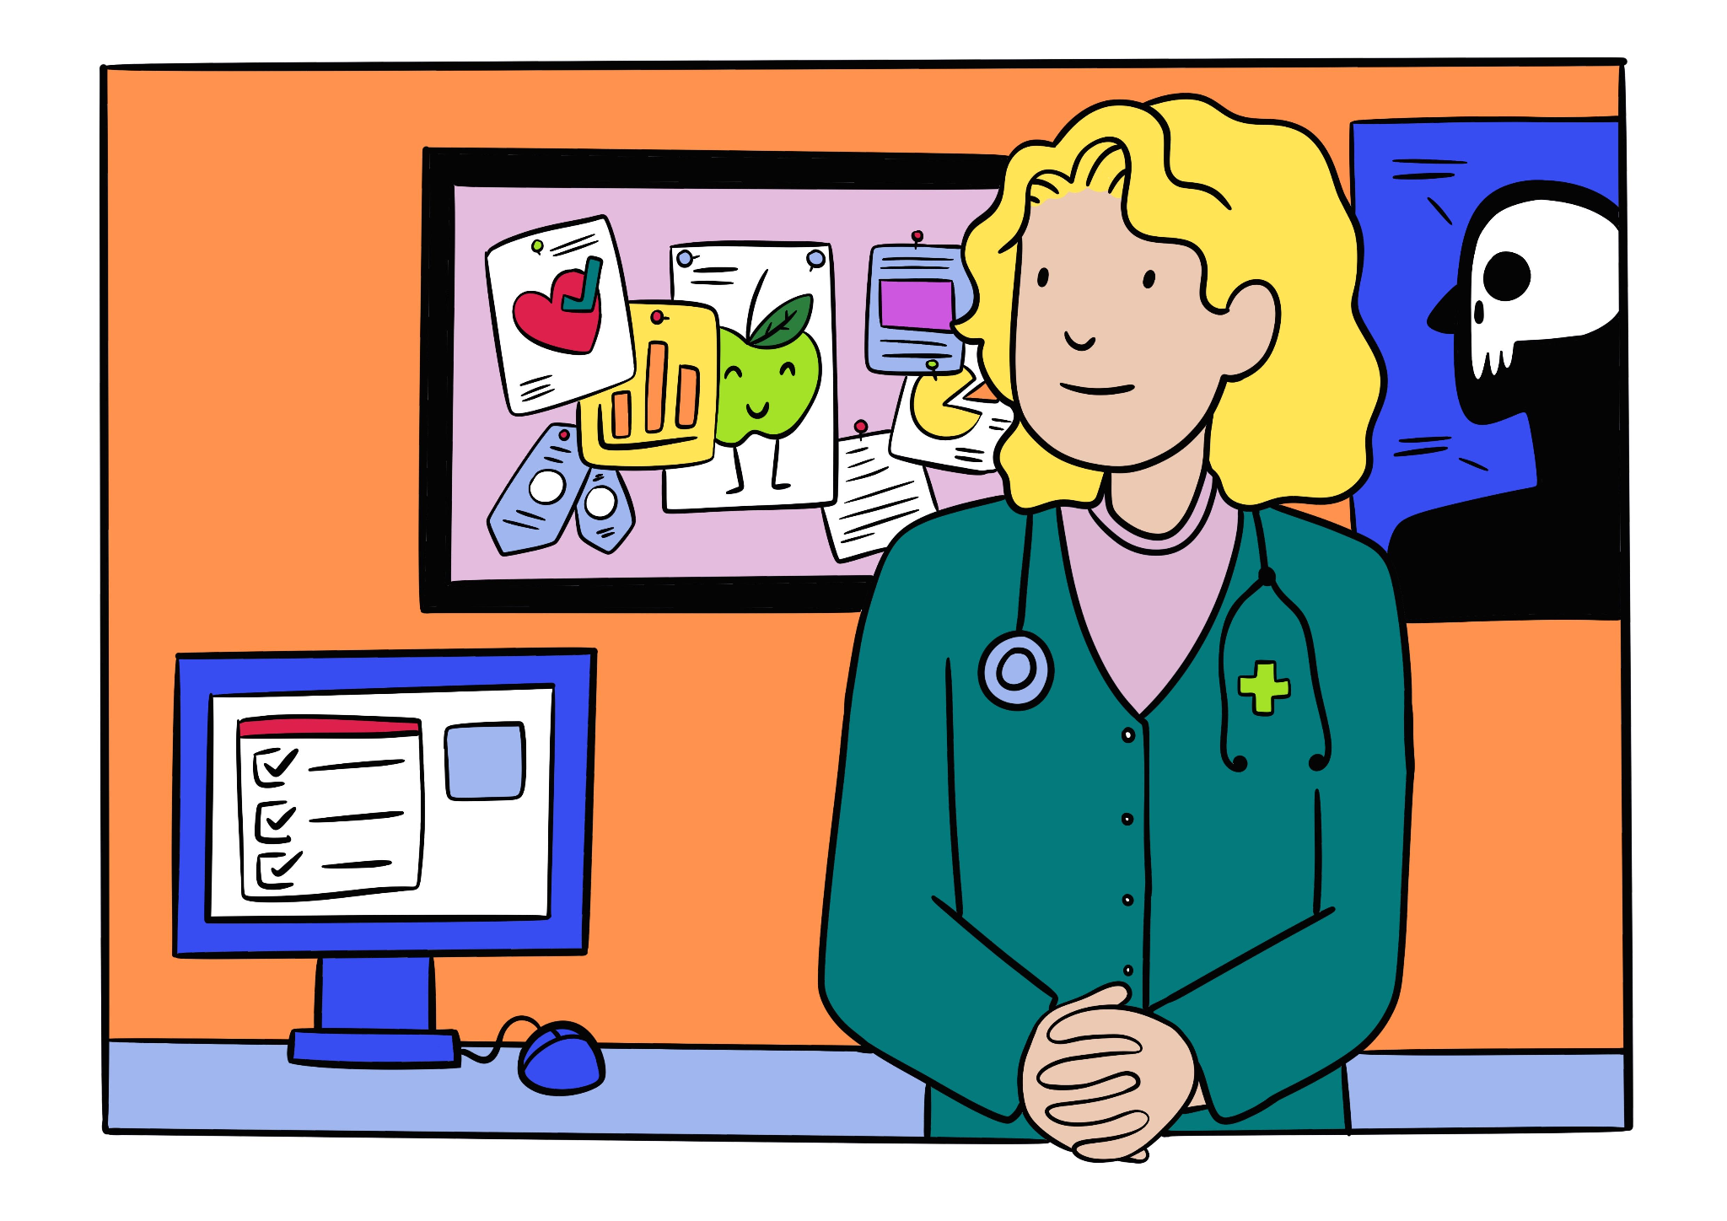
How is HIV transmitted?
Mother-to-child transmission can occur during pregnancy, childbirth or breastfeeding, but the chances of this can be reduced with proper medical care. With appropriate treatment during pregnancy, the risk of transmission from mother to child can be reduced to less than 1%.
Dr Elsie

Slide 26
How is HIV transmitted?
Finding out about HIV early and starting treatment straight away can help stop transmission.
HIV treatment works by lowering the amount of the virus in the body. When someone takes their medication consistently, the virus can become so low that it can’t be passed on during sexual contact.
This is called U=U (Undetectable = Untransmittable). It’s a proven fact: if the virus is undetectable, it can’t be passed on.
This helps protect others and also reduces the stigma around HIV.

Slide 27
How is HIV transmitted?
Early diagnosis and treatment can greatly reduce the transmission rates of HIV.

Slide 28
How is HIV transmitted?
Fill the gaps in the paragraph to explain how HIV can be transmitted:
Transmission rates of HIV depend on _______ factors, including the type of _______ and the presence of other _______. Unprotected sexual contact has an _______ transmission rate compared to _______ sex. Sharing _______ and syringes significantly _______ the risk of HIV _______. Mother-to-child transmission can occur during _______, childbirth or _______, but the chances of this can be reduced with proper _______ care. Consistent HIV treatment can cause the virus to become undetectable, which is known as _______.

Slide 29
How is HIV transmitted?
Your completed paragraph could look like this:
Transmission rates of HIV depend on several factors, including the type of exposure and the presence of other sexually transmitted infections (STIs). Unprotected sexual contact has an increased transmission rate compared to protected sex. Sharing needles and syringes significantly increases the risk of HIV transmission. Mother-to-child transmission can occur during pregnancy, childbirth or breastfeeding, but the chances of this can be reduced with proper medical care. Consistent HIV treatment can cause the virus to become undetectable, which is known as U=U.

Slide 30
Human immunodeficiency virus (HIV)
What is HIV?
How is HIV transmitted?
What are the prevention and treatment options?

Slide 31
What are the prevention and treatment options?
There are ways to prevent the spread of HIV, such as:
using condoms during sexual contact
not sharing needles and syringes
taking the medication Pre-exposure Prophylaxis (PrEP)
taking the medication Post exposure Prophylaxis (PEP)
Having regular HIV tests also helps stop the spread. This is known as ‘knowing your status’, which means finding out whether someone has HIV. If the virus is found early, treatment can begin straight away; helping protect the person’s health and prevent HIV from being passed on to others.

Slide 32
What are the prevention and treatment options?
PrEP is a medicine taken before sexual contact to protect against HIV.
It’s for people who don’t have HIV but may be at higher risk of getting it.
It lowers the chance of getting HIV from sexual contact by around 99% when taken correctly.
It’s important to note that it doesn’t protect against other STIs.
PrEP is freely available from NHS sexual health clinics after a health check.

Slide 33
What are the prevention and treatment options?
PEP is a medicine taken after possible exposure to HIV.
For example, after unprotected sexual contact or a needlestick injury.
You must start it within 72 hours (three days); the sooner, the better.
It’s a four-week course of tablets taken daily.
PEP is not guaranteed to work, so it’s used in emergencies only.
PEP can be accessed through NHS sexual health clinic or A&E in some cases.
Both PrEP and PEP are usually not issued by GPs or by pharmacies in most places in the UK.

Slide 34
What are the prevention and treatment options?
Complete the sentence with the missing words:
PrEP is a medicine taken _____ sexual contact to protect against HIV whilst _____ is a medicine taken after possible exposure to HIV.
before
PEP

Slide 35
What are the prevention and treatment options?
Getting tested for STIs is a responsible and normal part of looking after your health. You don’t need to wait for symptoms. Regular testing helps keep you and your partners safe.
You can:
order free STI test kits online, many local councils and NHS services will post them to your home discreetly
visit a local sexual health clinic for free and confidential tests.
Nurse Daniel

Slide 36
What are the prevention and treatment options?
When you go for a test, a nurse or doctor might ask you some questions to make sure you get the right tests. This is nothing to worry about. We’re trained to help, not judge! If you’re feeling nervous, you could take someone you trust with you. Knowing your HIV status means you can take action if needed, protect others and feel confident in your own health. Testing helps challenge stigma and shows that you take care of yourself and others.
Dr Elsie

Slide 37
What are the prevention and treatment options?
Which of the following are ways to prevent the spread of HIV?
taking medication like PrEP
using condoms during sexual contact
sharing needles
regular STI and HIV testing

Slide 38
What are the prevention and treatment options?
Without treatment, HIV can lead to acquired immunodeficiency syndrome (AIDS), the final stage of HIV infection.
AIDS is characterised by a severely weakened immune system, making the body vulnerable to opportunistic infections and certain cancers.
However, with modern treatment, very few people with HIV in the UK develop AIDS.

Slide 39
What are the prevention and treatment options?
Antiretroviral therapy (ART) is a treatment that helps people with HIV by lowering the amount of the virus in their body, protecting CD4 cells, which are needed to fight infections and stay healthy. Therefore, a person will be more likely to avoid the virus’ progression to AIDS.
Nurse Daniel

Slide 40
What are the prevention and treatment options?
With effective ART, people living with HIV can:
live a normal lifespan
have healthy relationships and families
work and participate fully in society
achieve undetectable levels of the virus, meaning they cannot transmit HIV to others (U=U).

Slide 41
What are the prevention and treatment options?
Even with treatment, HIV will always progress to AIDS.
Why?
ART helps control HIV by lowering the virus in the body, protecting CD4 cells that fight infections and keep people healthy, lowering the chances of the virus developing into AIDS.

Slide 42
What are the prevention and treatment options?
Answer the following questions:
List three different ways that the transmission of HIV can be prevented.
Explain how ART helps people with HIV.

Slide 43
What are the prevention and treatment options?
Your answers might have included:
List three different ways that the transmission of HIV can be prevented.
using condoms during sexual contact
not sharing needles or syringes
regular STI and HIV testing.
Explain how ART helps people with HIV.
ART lowers the amount of HIV in a person’s body and protects CD4 cells, which are needed for a healthy immune system and will enable a person to fight infections and reduce their chances of developing AIDS.

Slide 44
Human immunodeficiency virus (HIV)
HIV attacks the immune system, specifically targeting CD4 cells. It is transmitted through bodily fluids and so it can affect anyone.
Transmission rates can vary based on factors such as type of exposure and presence of other STIs.
HIV can lead to AIDS if left untreated, which severely weakens the immune system. However, with modern treatment, most people in the UK with HIV do not develop AIDS.
There are effective ways to prevent HIV, like using condoms and medicines such as PrEP and PEP. Treatment like ART helps people with HIV stay healthy.

Slide 45
Where to get support
NHS website
NHS advice about health and prevention, including how to access services.
Childline
A website and phone line which is able to offer confidential advice and support.

