Slide 1
PSHE

Slide 2
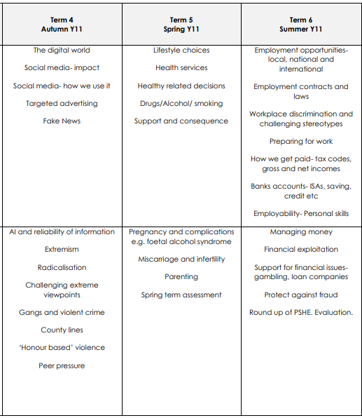
Year 11

Slide 3



Health and wellbeing
Relationships
Wider world

Slide 4
Wider world
Tuesday 30th September 2025
The digital world

Slide 5


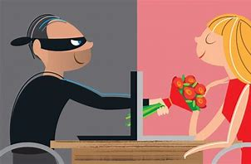
Big Picture
Aims
Online relationship principles
Online behaviour

Slide 6







What is data?
Progress Check
What does GDPR stand for?
Explain two pieces of Personal Information.
What should a privacy statement include?
How can you request your data from an organisation?
Question time

Slide 7

Activate
Examples:
What are the risk of sharing personal data (information) online?

Slide 8



Connect
Rules for staying safe online
Introduction and ready to learn
Notes:
Child Exploitation and Online Protection Command
National Society for the Prevention of Cruelty to Children

Slide 9

Personal values
Honesty Being truthful and transparent in words and actions. | Respect Valuing others’ feelings, rights, and beliefs. | Kindness Showing compassion, care, and generosity. | Responsibility Owning your actions and fulfilling your duties.
Fairness Treating everyone justly without favoritism or prejudice. | Gratitude Appreciating what you have and showing thankfulness. | Perseverance Staying committed and resilient in the face of challenges. | Humility Staying modest, open to learning, and not arrogant.
Courage Doing the right thing even when it is hard or risky. | Forgiveness Letting go of grudges and giving others a second chance. | Empathy Understanding and sharing the feelings of others. | Loyalty Being faithful and dependable in relationships and commitments.

Slide 10
Values that help when considering data sharing online:

Slide 11
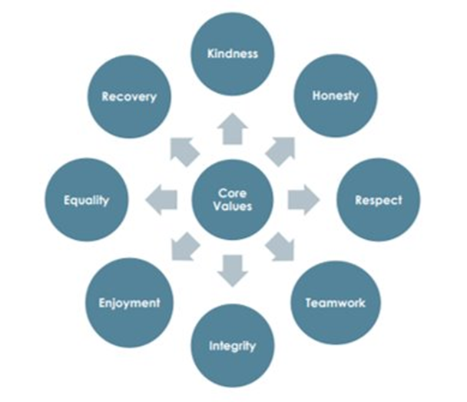
How should people behave online?
5 values

Slide 12

Activate
Disinformation - Fake news
Fake News - BBC Teach
Notes:
Fake News - BBC Teach

Slide 13
Progress Check
Fake news
What are the five top tips for considering reliability of news?
Five top tips for considering reliability of news are:

Slide 14
Create a poster/flyer for children aged 5-10 about rules to stay safe online.
Challenge: provide some advice/guidance for parents about how to keep their child safe using digital devices

Slide 15

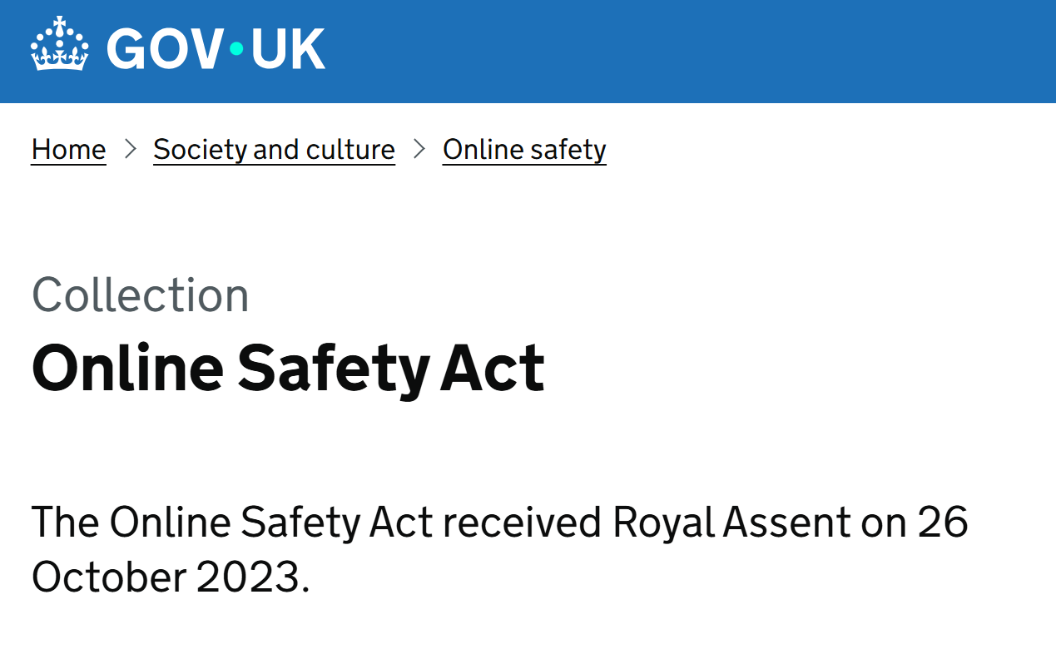
Consolidate
Independent regulator will be appointed to enforce stringent new standards
Social media firms must abide by mandatory “duty of care” to protect users and could face heavy fines if they fail to deliver
Measures are the first of their kind in the world in the fight to make the internet a safer place

