Slide 1
Impact of Pornography

Slide 2
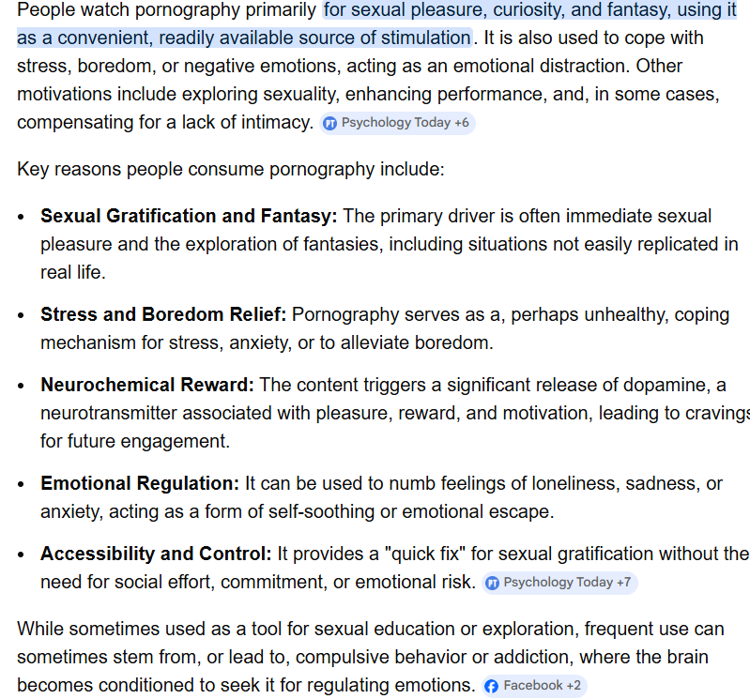
Why do people watch?

Slide 3
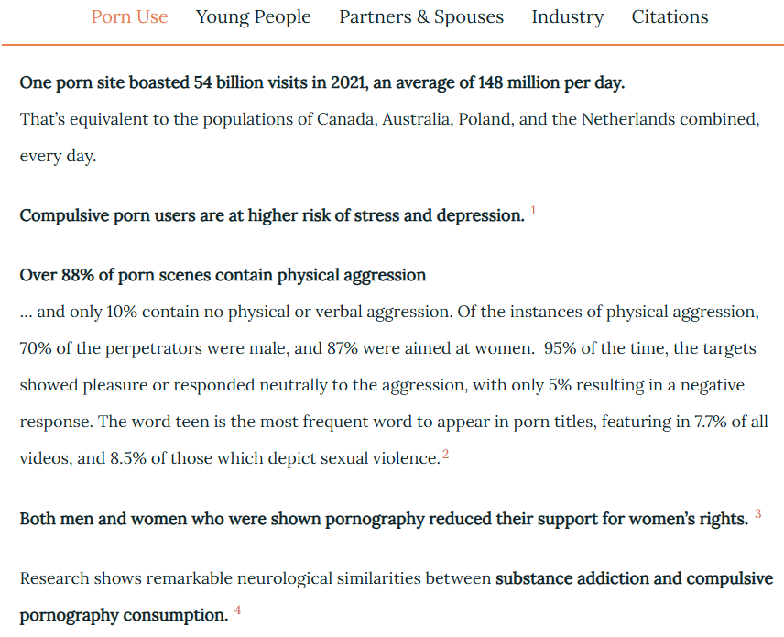
Naked Truth

Slide 4
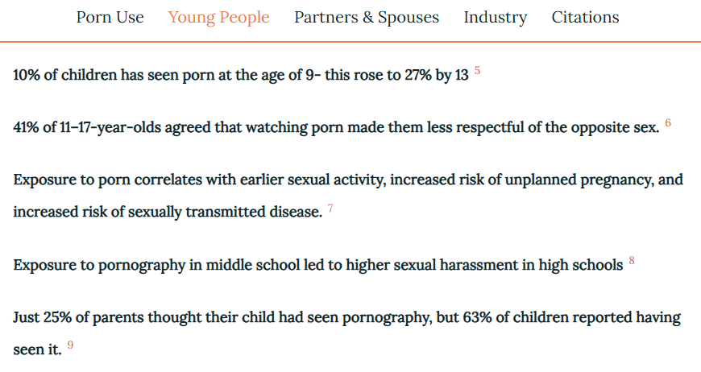

Slide 5
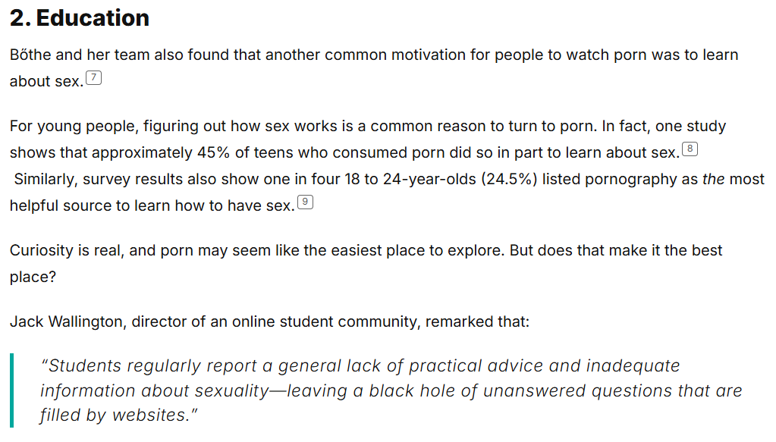
Notes:
5 Basic Reasons Why People Choose to Watch Porn

Slide 6
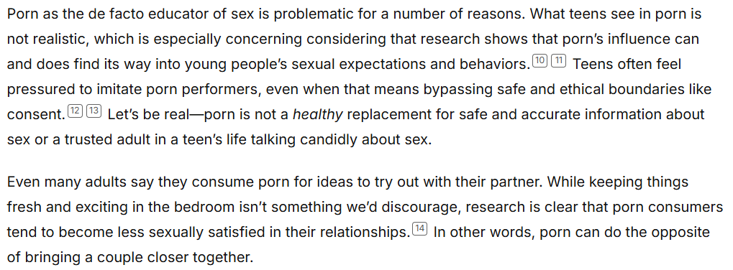
Notes:
5 Basic Reasons Why People Choose to Watch Porn

Slide 7
Pornography - Intro

Slide 8
Teaching Porn Awareness

Slide 9
Take home messages?

