Slide 1


Connect
DATE
Marriage, Civil Partnerships and Cohabitation

Slide 2

Connect
Write as many ways to celebrate something as you can.
Brain dump

Slide 3
Big Picture
The Law
Until the middle of the 18th century marriages could take place anywhere provided they were conducted before an ordained clergyman of the Church of England. This encouraged the practice of secret marriages which did not have parental consent and which were often bigamous.
Minimum age
In 1929, in response to a campaign by the National Union of Societies for Equal Citizenship, Parliament raised the age limit to 16 for both sexes in the Ages of Marriage Act.
This changed in February 2023 to the age limit of 18 years old.

Slide 4
Big Picture
Marriage (Same Sex Couples) Act 2013
In 2013, Parliament passed the Marriage (Same Sex Couples) Act which introduced civil marriage for same-sex couples in England and Wales. The legislation allowed religious organisations to opt in to marry same-sex couples should they wish to do so and protected religious organisations and their representatives from successful legal challenge if they did not wish to marry same-sex couples. The legislation also enabled civil partners to convert their civil partnership into marriage and transsexual people to change their legal gender without necessarily having to end their existing marriage.
In Scotland, the Scottish Parliament has legislated to allow same-sex marriages. The Northern Ireland Assembly has not legislated to allow the marriage of same-sex couples in Northern Ireland.
The first same-sex marriages in England and Wales took place in March 2014.

Slide 5

Marriage
Activate
It must be freely entered into.
How do people show these values in a marriage?
Trust
Respect
Honesty
Kindness
Generosity
Boundaries
Privacy
Consent
Management of conflict
Reconciliation

Slide 6







A marriage/civil partnership will be illegal/void if:
• the couple are closely related (a parent, child, brother, sister, niece, nephew, aunt, uncle, grandparent, grandchild)
• either person is already married or in a civil partnership
• either person is under 18
Progress Check
• Mixed sex couples (i.e. couples who are not of the same sex) can now form a civil partnership in the UK. Civil partnership were extended to opposite sex couples in England and Wales during 2019.
• Same sex marriage is legal in England, Scotland and Wales and was made legal in Northern Ireland from January 2020.
• Arranged marriage is legal as long as both people give their consent and the marriage is entered into freely.
• Forced marriage is where one or both people do not (or in cases of people with learning disabilities or reduced capacity, cannot) consent to the marriage as they are pressurised, or abuse is used, to force them to do so.

Slide 7

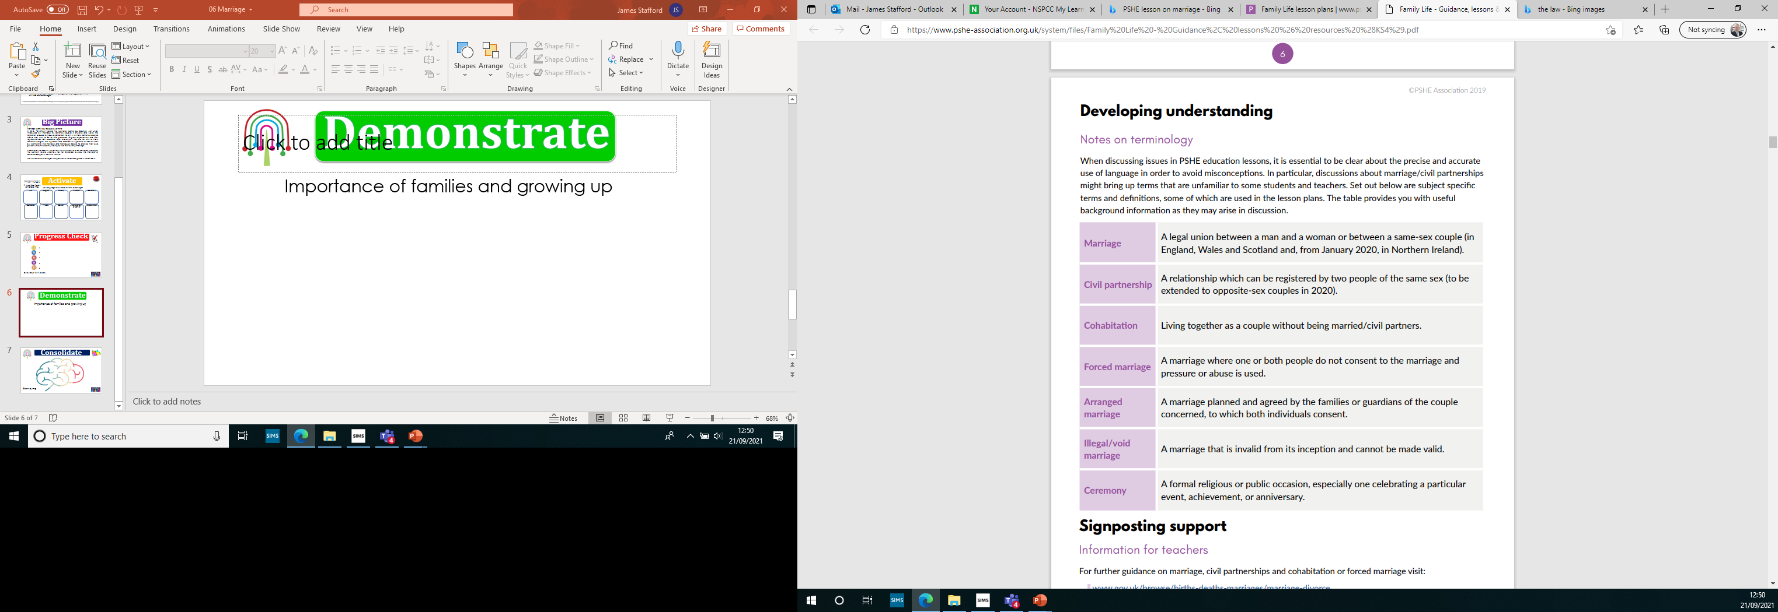

Slide 10

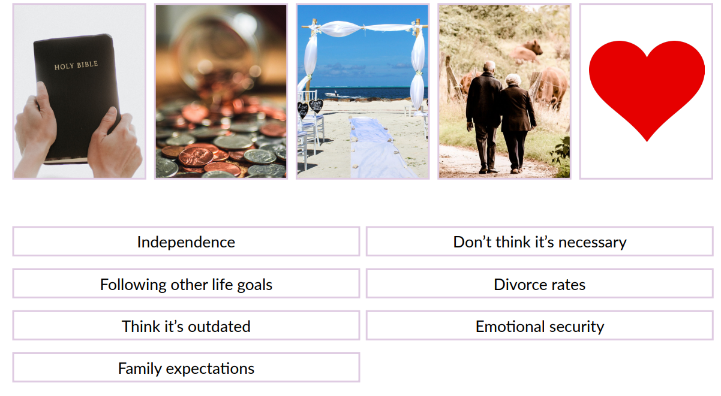
Time to check everything you have learnt in this lesson and put it all together
Consolidate
Discuss the words and images below into reasons people choose to marry/form a civil partnership and reason people decide not to.

