Slide 1
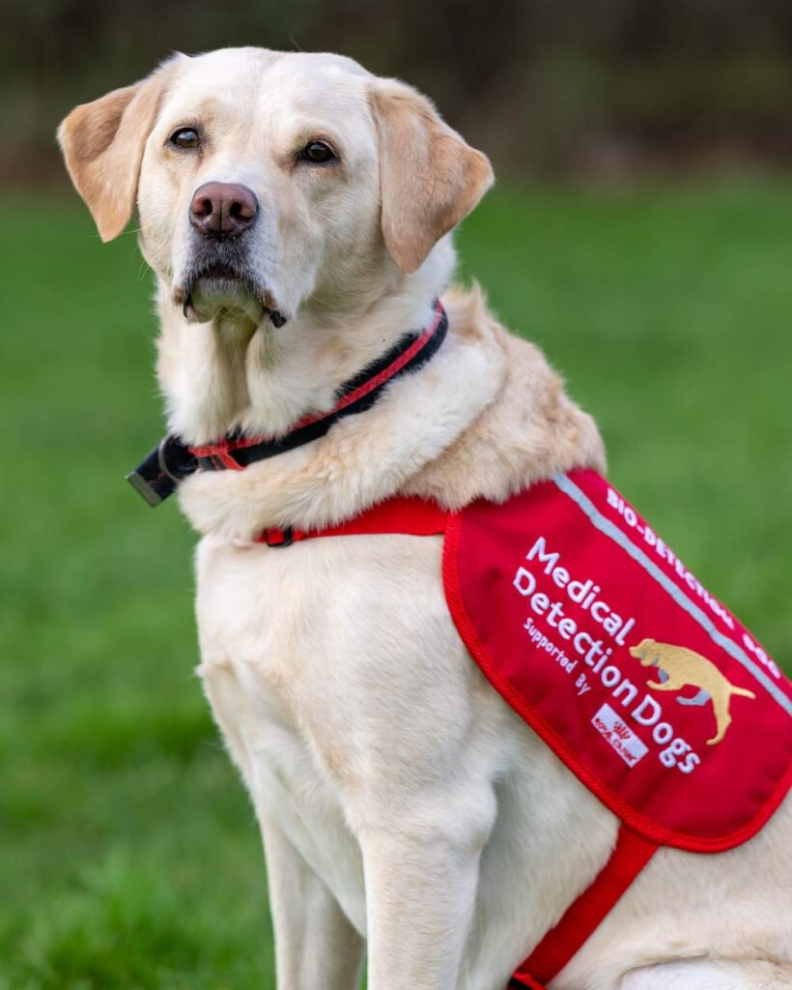
Dogs in UK Are First to Be Trained to Sniff Out Bowel Cancer–After Nailing Parkinson’s and COVID
Notes:
These clever dogs are the first in the UK to be trained to sniff out bowel cancer.
The Medical Detection Dogs charity began a groundbreaking study in 2024 to teach seven pooches how to detect tumors simply by smelling urine in pots.
Following the first part of their training, the cocker spaniels, Labradors, and retriever are showing real signs of success.

Slide 2

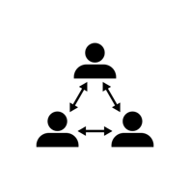

Health and wellbeing
Relationships
Wider world

Slide 3
Relationships
DATE
Consent

Slide 4

To learn about what consent means, both legally and ethically, and what it looks like in practice.
We will be able to:
explain what consent means, both legally and ethically, and why it is so important.
describe how to recognise when a person is consenting and when they are not.
explain how consent is sought, given and not given in a healthy relationship.
describe or demonstrate what to say and do to seek the consent of another person.

Slide 5
Consent mind map
Consent is an agreement by choice made by someone with the freedom and capacity to consent.
Create your mind map, showing what you know about the term ‘consent’.
Add any questions you have to the box at the bottom of the sheet.

Slide 6

Parallel lines
This activity will help us to understand how consent works in practice.
Stand in two opposite lines.
Listen carefully to the instructions and make sure you listen to your partner.

Slide 7
Parallel lines
With whom does the responsibility for stopping lie?
Why do you think people asked the other person to stop at different distances away?
How did it feel to be able to say ‘stop’ and have that respected?
How would it have felt if the opposite person had continued taking a step forward after being asked to stop?

Slide 8

Parallel lines
Round 2: Swap roles and listen carefully to the instructions.
Have we stopped in similar places to last time?
Was it easier or harder to communicate when to stop using non-verbal cues?
Was it easier or harder to know when the other person wanted you to stop using non-verbal cues?

Slide 9
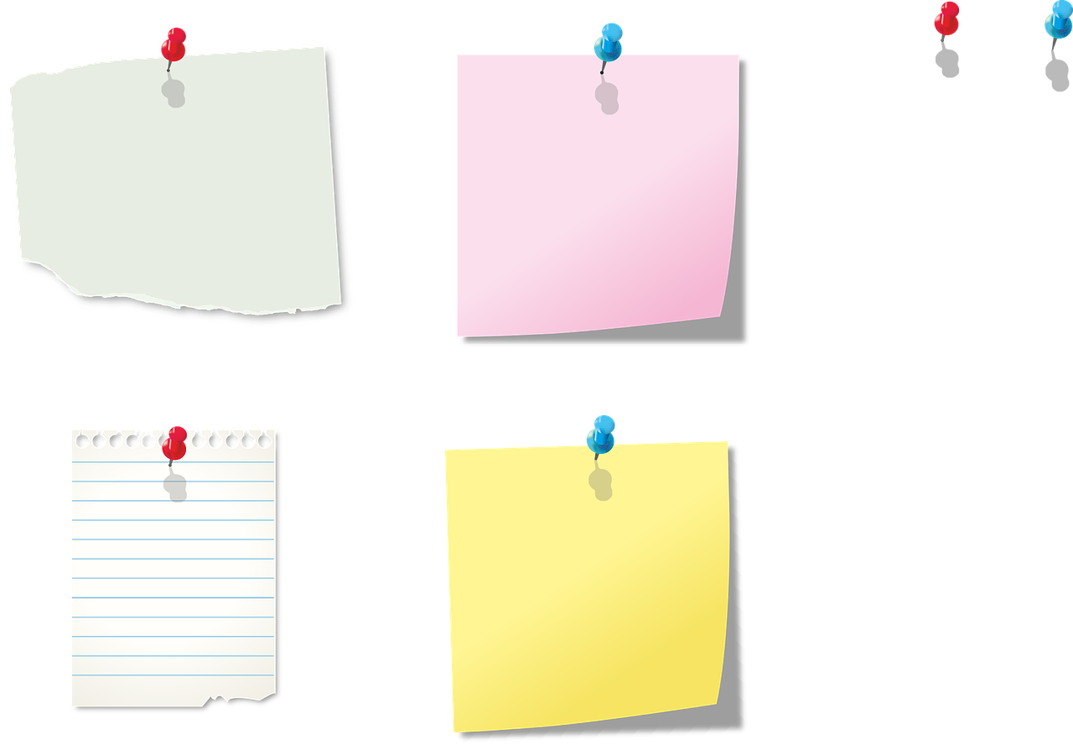
Non-verbal cues
Thinking about behaviour now, how do people behave when…
…they are happy with what someone is suggesting or doing?
…they don’t like (or no longer like) what someone is suggesting or doing?
Write your ideas on the post-it notes and bring them to the front.

Slide 10
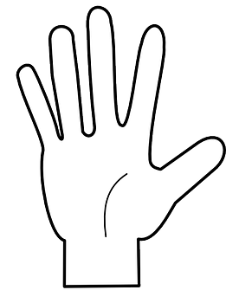
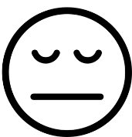
Non-verbal cues
How people show with their words… | How people show with their facial expressions… | How people show with their body language..
If someone wasn’t sure whether the other person was giving their consent, how could they check?

